Slide 1
Design ‘Patterns’ {
index.html
styles.css
< Svetlichnaya Alina &&
Shabanova Anastasia >
}
English language

Slide 2
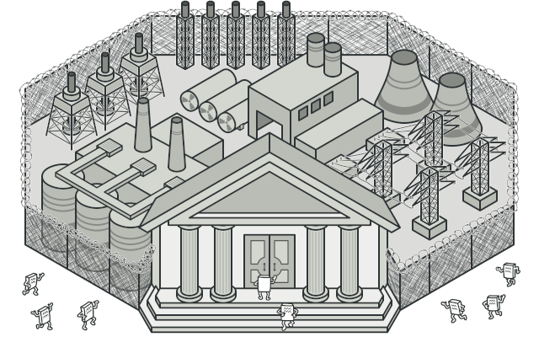
Facade {
index.html
styles.css
is a structural design pattern that provides a simplified interface to a library, a framework, or any other complex set of classes
}
English language

Slide 3
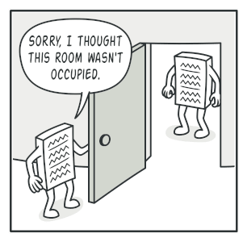
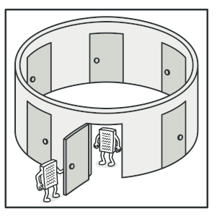
02 {
[Singleton]
index.html
styles.css
< is a creational design pattern that lets you ensure that a class has only one instance, while providing a global access point to this instance >
}
English language

Slide 4
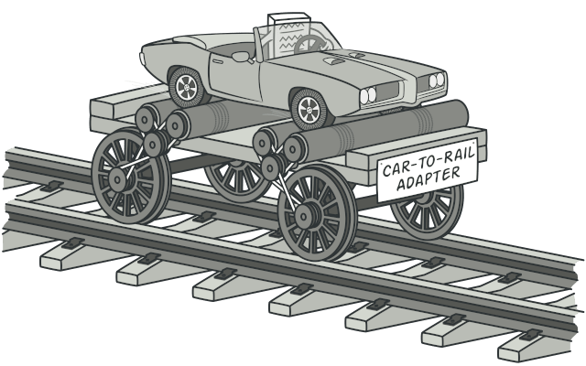
Adapter {
index.html
styles.css
is a structural design pattern that allows objects with incompatible interfaces to collaborate
Photos:
}
English language

Slide 5

Thank ‘You’ For { Your Attention
}

